Slide 1
Neural Style Transfer

Slide 2
About Neural Style Transfer
Imagine that you could transfer the style of Picasso into your own pieces of art. Your paintings would look exactly as if Pablo Picasso was actually the one creating them.
In fact, if presented side by side, they would be so indistinguishable that nobody could tell the difference.
Sounds pretty crazy, right?
Well, not if we are discussing Machine Learning.
You see, there's a class of Convolutional Neural Networks that offers an interesting solution, which makes this achievable using Deep Learning and Neural Networks-
Meet “Neural Style Transfer”

Slide 3
Index
01
02
03
How does Style Transfer work?
Setup and Code
Style Transfer basic structure
04
05
Style Transfer use cases
Efforts by

Slide 4
How does Style Transfer work?
The aim of Neural Style Transfer is to give the Deep Learning model the ability to differentiate between the style representations and content image.
NST employs a pre-trained Convolutional Neural Network with added loss functions to transfer style from one image to another and synthesize a newly generated image with the features we want to add.
Style transfer works by activating the neurons in a particular way, such that the output image and the content image should match particularly in the content, whereas the style image and the desired output image should match in texture, and capture the same style characteristics in the activation maps.
These two objectives are combined in a single loss formula, where we can control how much we care about style reconstruction and content reconstruction.

Slide 5
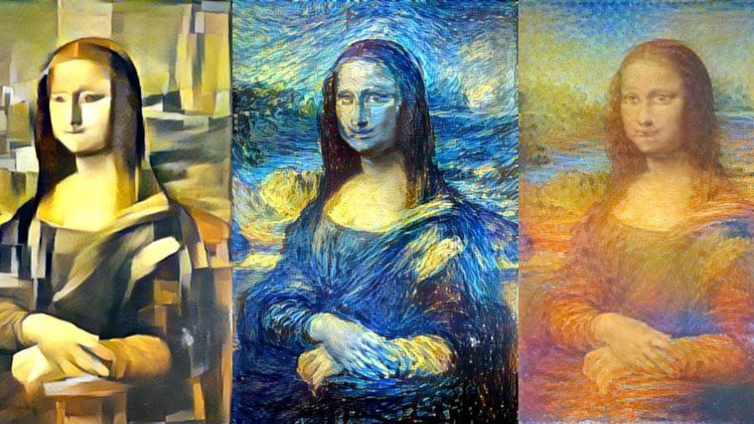
What would it look like if Vincent van Gogh or some other artists decided to paint the Mona Lisa exclusively with their style? Something like this?

Slide 6
Setup and Code
Importing Libraries required for Neural Style Transfer.
Defining some utility functions for Neural Style Transfer.
Computing losses of Neural Style Transfer model.
Training our Neural Style Transfer model.
01
02
03
04
05
06
07
Read the content and style images.
Loading the VGG model for Neural Style Transfer.
Defining Evaluator class.

Slide 7
Code

Slide 11
Neural Style Transfer basic structure
Training a style transfer model requires two networks: a pre-trained feature extractor and a transfer network.
NST uses a pre-trained model trained on ImageNet- VGG in TensorFlow.
Images themselves make no sense to the model. These have to be converted into raw pixels and given to the model to transform it into a set of features, which is what Convolutional Neural Networks are responsible for.
Thus, somewhere in between the layers, where the image is fed into the model, and the layer, which gives the output, the model serves as a complex feature extractor. All we need to leverage from the model is its intermediate layers, and then use them to describe the content and style of the input images.
The input image is transformed into representations that have more information about the content of the image, rather than the detailed pixel value.
The features that we get from the higher levels of the model can be considered more related to the content of the image.
To obtain a representation of the style of a reference image, we use the correlation between different filter responses.

Slide 12
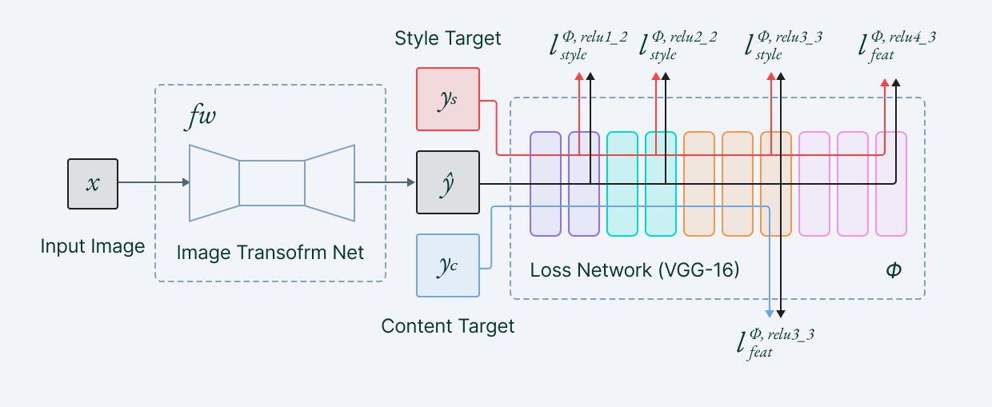
Neural Style Transfer basic structure

Slide 13

Neural Style Transfer basic structure
Content loss
It helps to establish similarities between the content image and the generated image.
It is intuitive that higher layers of the model focus more on the features present in the image i.e. overall content of the image.
Content loss is calculated by Euclidean distance between the respective intermediate higher-level feature representation of input image (x) and content image (p) at layer l.
It is natural for a model to produce different feature maps in higher layers being activated in the presence of different objects.
This helps us to deduce that images having the same content should also have similar activations in the higher layers.

Slide 14
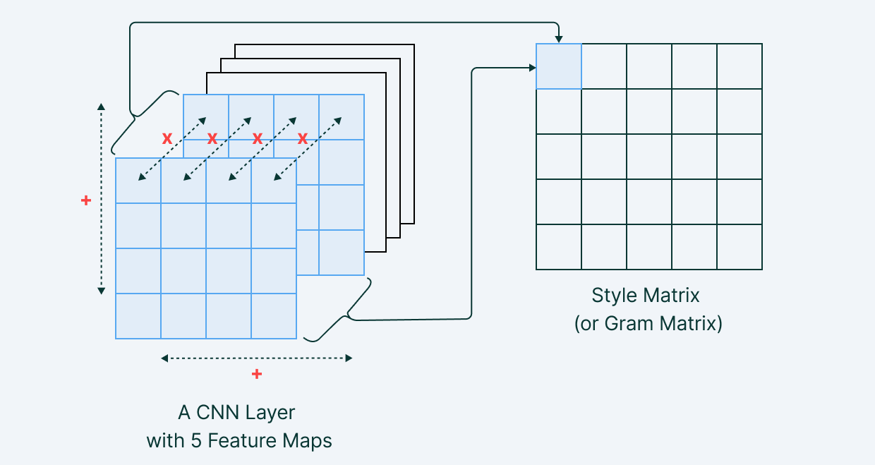
Neural Style Transfer basic structure
Style loss
Style loss is conceptually different from Content loss.
We cannot just compare the intermediate features of the two images and get the style loss.
That's why we introduce a new term called Gram matrices.
Gram matrix is a way to interpret style information in an image as it shows the overall distribution of features in a given layer. It is measured as the amount of correlation present between features maps in a given layer.

Slide 15


Style loss is calculated by the distance between the gram matrices (or, in other terms, style representation) of the generated image and the style reference image.
The contribution of each layer in the style information is calculated by the below formula:
Thus, the total style loss across each layer is expressed as:
where the contribution of each layer in the style loss is depicted by some factor wl.

Slide 16
Neural Style Transfer use cases
01
Photo and video editors
Style transfer is extensively used in photo and video editing software.
These deep learning approaches and professional style transfer models can easily be applied to devices like mobile phones and give users a real-time ability to style images and videos.
02
Art and entertainment
Style transfer also provides new techniques that can change the way we look and deal with art.
It makes high-rated and over-priced artistic work reproducible for office and home decor, or for advertisements. Transfer models may help us commercialize art.
03
Gaming and VR
There are many cloud-powered video game streams that use image style transfer.
These models help the developers to provide interactive environments with customized artistic styles to users. This provides a 3D touch to the game and helps to enrich the artist inside every developer.
Much similar to gaming, VR apps help to tell visual stories through their applications, games, films, and more.

Slide 17
Efforts by:
Deepkirat Singh RA2011047010057
Umang Kumar RA2011047010047
Animesh Agnihotri RA2011047010069

